Slide 1
EUFIC : bridging informational gaps for a better management of emerging risks
EFSA StaDG-ER meeting
Brussels, November 2024

Slide 2
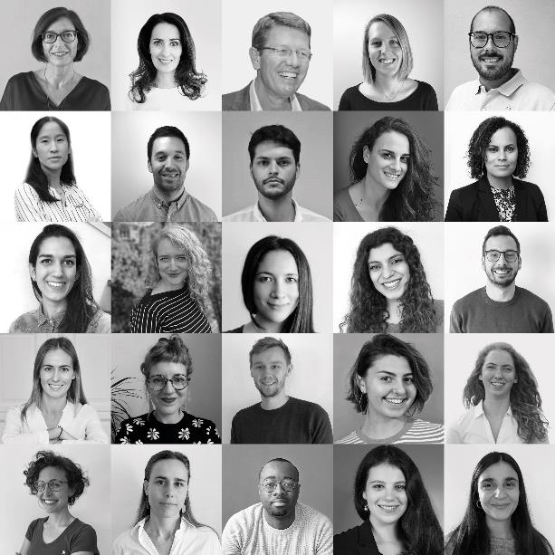
Who we are
A consumer-oriented
non-profit founded to make the science behind food and health more accessible and easier to understand.

Slide 3
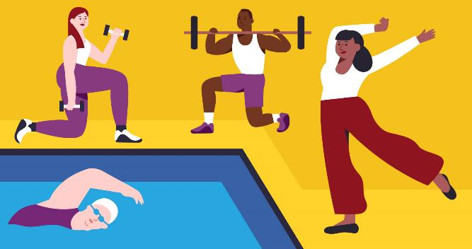
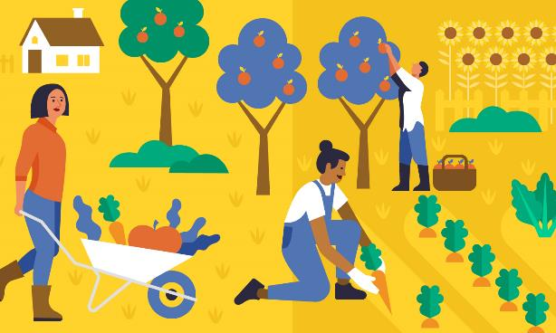
Our vision
A world where we live healthier and more sustainable lives because we all know how to.
Our Mission
We empower and facilitate healthier and more sustainable diets and lifestyles through science-based information and activities.
Notes:
EUFIC is a non-profit organisation that has been around for almost 30 years, based in Brussels
We support consumers in adopting healthier and more sustainable diets through our communication and activities that are founded on science-based information.

Slide 4

Our values
Impartiality and scientific integrity
sit at the heart of all we do.
All our content is derived from peer-reviewed science and authoritative bodies such as the WHO, FAO and European authorities, and reviewed by an independent Scientific Advisory Board.

Slide 5

Our long-term goals
to build food &
health science literacy
& promote evidence-based decision-making
to facilitate the
healthy & sustainable
diet shift
to support the prevention of diet- and lifestyle-related NCDs
to empower
food waste reduction
at consumption level
Notes:
Here are the main topics we work on.
The first is food and health science literacy, of which this survey falls under. This is to help promote evidence-based decision-making not only in consumers, so they know the effects of different ways of eating on their health, but also for various stakeholders, who can apply our research to improve their activities.
Another key area for us is to facilitate the healthly and sustainable diet shift, which involves reducing excess meat consumption, and eating a more plant-forward diet.
We also work on supporting and preventing diet and lifestyle related non-communicable diseases, such as cardiovascular disease and diabetes type 2,
and last but not least, we aim to empower consumers reduce their food waste, as part of a more sustainable dietary practice.

Slide 6




What we do on a daily basis
translate complex food & nutrition science into accessible, relevant and trustworthy content, for
European citizens
counter misrepresentation
of science and encourage critical thinking
gather, use and communicate
pan-European consumer insights
promote evidence-based decision making
Notes:
This can include creating content, developing and implementing communication campaigns, and conducting consumer research, of which our food literacy survey is an example. We also collaborate with other organisations and are involved in EU projects for some of these activities.

Slide 7







Our tools
Science
Outreach & dialogue
Capacity-building
Consumer research
to better understand people’s behaviour, information needs
Awareness raising &
public engagement
online and on the ground, directly and through multipliers
Media resources
to improve science reporting, counter misrepresentation
of science
Food & health science
to capture the state of the scientific debate on key issues
Trainings
to improve science communication at
its core
Science-based dialogue
from stakeholder engagement to neutral platforms for debate
The science of
Science Communication
to inform EUFIC’s work
Collaboration

Slide 8
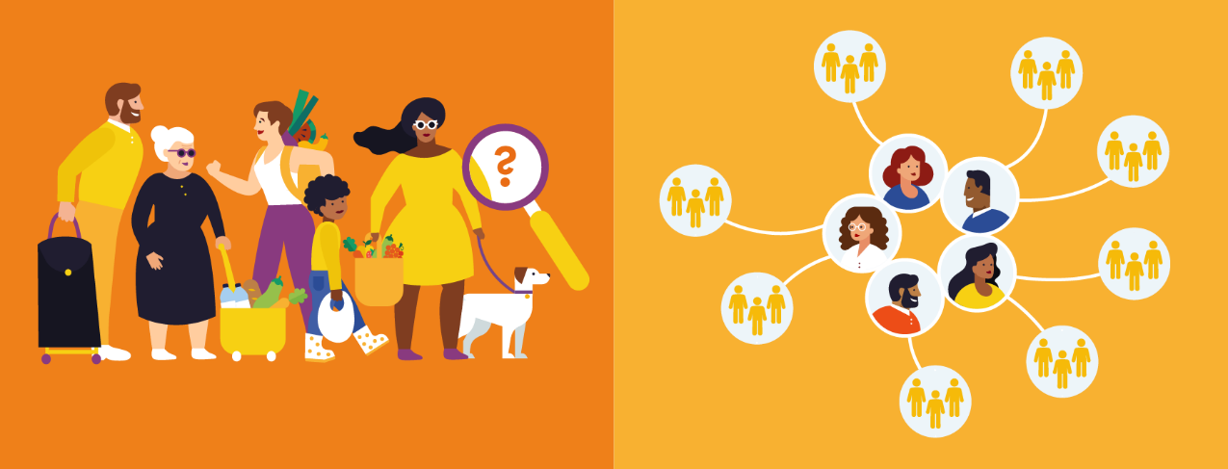
Our audiences
Consumers
Multipliers

Slide 9




A unique model
Trust & engagement from the public,
credibility & recognition by stakeholders
Passionate & committed team of experts
European Network of 700+
Impartial
voice
Consumers at
our heart

Slide 10
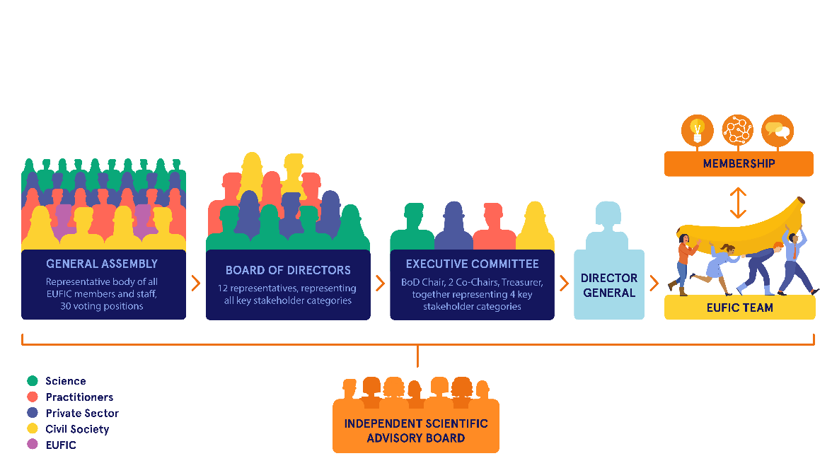
Our governance
Representing sectors that are key to fulfilling our mission:
Scientific community, healthcare and science communication practitioners, private sector, civil society

Slide 11
Our funding in 2023
Membership 31%
Other 2%
Public sources 67%
Horizon 2020 and horizon Europe projects (39%)
EIT Food projects (3%)
Operating Grant (22%)
Erasmus+ (2%)
EUFIC members can be found at: EUFIC membership | Eufic
EU projects we are involved in can be found at: European projects | Eufic

Slide 12






EUFIC in numbers
> 2,000 articles
on our website
> 145 K social media following
70+ EU Projects
22 ongoing
Average > 890 media mentions in 2023
28 permanent staff
5 PhDs
~3 million users
in 2023 at eufic.org
Notes:
Those are the 2023 indicators,

Slide 13
Our member community
AARHUS UNIVERSITY MAPP CENTER
AGRICULTURAL UNIVERSITY OF ATHENS
AIRFIELD
BUNGE
CARGILL
CEMAS
COCA-COLA
CPW
EFAD
EUROFIR
FERRERO
FINS
FOOD2KNOW
FRUCOM
GENERAL MILLS
HERO GROUP
IKEA
MARS
MONDELĒZ
NESTLÉ
NNEDPRO
NUTRIS NUTRITION INSTITUTE LJUBLJANA
PEPSICO
ROQUETTE
SABRI ÜLKER FOUNDATION
UNILEVER
UNIVERSITY OF BOLOGNA
UNIVERSITY COLLEGE DUBLIN
UNIVERSITY
OF PARMA
UNIVERSITY
OF LEEDS
YILDIZ HOLDING
YILDIZ TECHNICAL UNIVERSITY
WASTELESS
FOUNDATION
Full members (15)
Associate members (18)

Slide 14



























Project involvement by long-term goal
COMBINE
to build food & health science
literacy & promote evidence-based
decision-making
to facilitate the
healthy & sustainable diet shift
to support the prevention of diet- and lifestyle-related NCDs
to empower food
waste reduction at
consumption level

Slide 15
Consumer research at EUFIC
Notes:
EUFIC’s in-house consumer scientists help the EUFIC team and our networks better understand consumers’ attitudes and behavior towards food, strengthening the consumer focus across our work.
We also actively listen to people’s needs and questions through our interactions on social media and their queries online.
Our resources are brought to the public via our own outreach channels – in particular our social media platforms,
as well as through collaborations with a wide network of authoritative partners in the food and health space.

Slide 16
Types of works we do
Exploring consumer attitudes towards and preferences for foods, brands, food technologies, food safety, food information, food production methods, and food system issues
Carrying out analytic research on choice behaviour (which products/foods are chosen over others and why)
Exploring the determinants of choice behaviour / decision making :
  attitudes people hold to information provided to them, (e.g., food labels or information campaigns)
  choice environment like in-store settings or settings at cafeterias/canteens)
Analysing purchase behaviour (e.g., scanner data analysis, sales analysis, observation and surveys on purchase preferences etc.)
Exploring consumption behaviour : cross-sectional studies in controlled environments like lab settings, field experiments in canteens/cafeterias/in-store, panel data analysis over time etc.

Slide 17
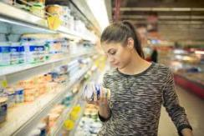


Methodologies we operate and propose
Experimental design (e.g., on food labels)
Questionnaire design (e.g., on consumer trust in the food value chain)
Designing and conducting interviews/focus groups (e.g., with stakeholders and consumers on short food supply chains)
Quantitative and qualitative data analysis (e.g., on food technology and food packaging)
Social media discussions moderation and analysis (e.g. on vertical farming)
Literature reviews (e.g., on food waste)
Scientific publications (e.g., on food choice behaviour)
Conference presentations (e.g., own research, state-of-the-art on a given topic)
Consumer training (e.g., on nudging, heuristics, research methodology)

Slide 18

Examples of activities :
1) Focus groups on short food supply chains
Focus groups were designed and carried out in 4 countries (Germany, Spain, Greece and Hungary),
Covering :
consumer attitudes and value perceptions towards short food supply chains,
their perceived risks and benefits,
potential intrinsic and extrinsic product attributes that would increase likelihood of choice and purchase decisions

Slide 19

Examples of activities :
2) Expert interviews with short supply chain actors
Face-to-face interviews were designed and carried out with relevant stakeholders,
Covering :
insights into food supply chain mechanisms,
specific requirements in shortening supply chains,
challenges and opportunities for short supply chains
perceived consumer acceptance.

Slide 20

Examples of activities :
3) Consumer survey on short food supply chains
Quantitative research to validate and quantify consumer expectations, attitudes and preferences towards food provided by short food supply chains, their value perceptions as well as adoption motivators and barriers.
Data collected through an online survey in 4 countries (Germany, Spain, Greece and Hungary) with a target sample size of 500 consumers in each country.
Descriptive and explanatory analyses performed on :
consumer socio-demographics characteristics (e.g., age, marital status, household size, education, income, employment, etc.), in combination with
attitudes and preferences,
values,
intent to purchase/willingness-to-pay, etc.

Slide 21
What do consumers know about food?
Extracts of a European consumer survey on food and health literacy
European Food Information Council (EUFIC)
June 25, 2024
Grant agreement n° 101124527

Slide 22
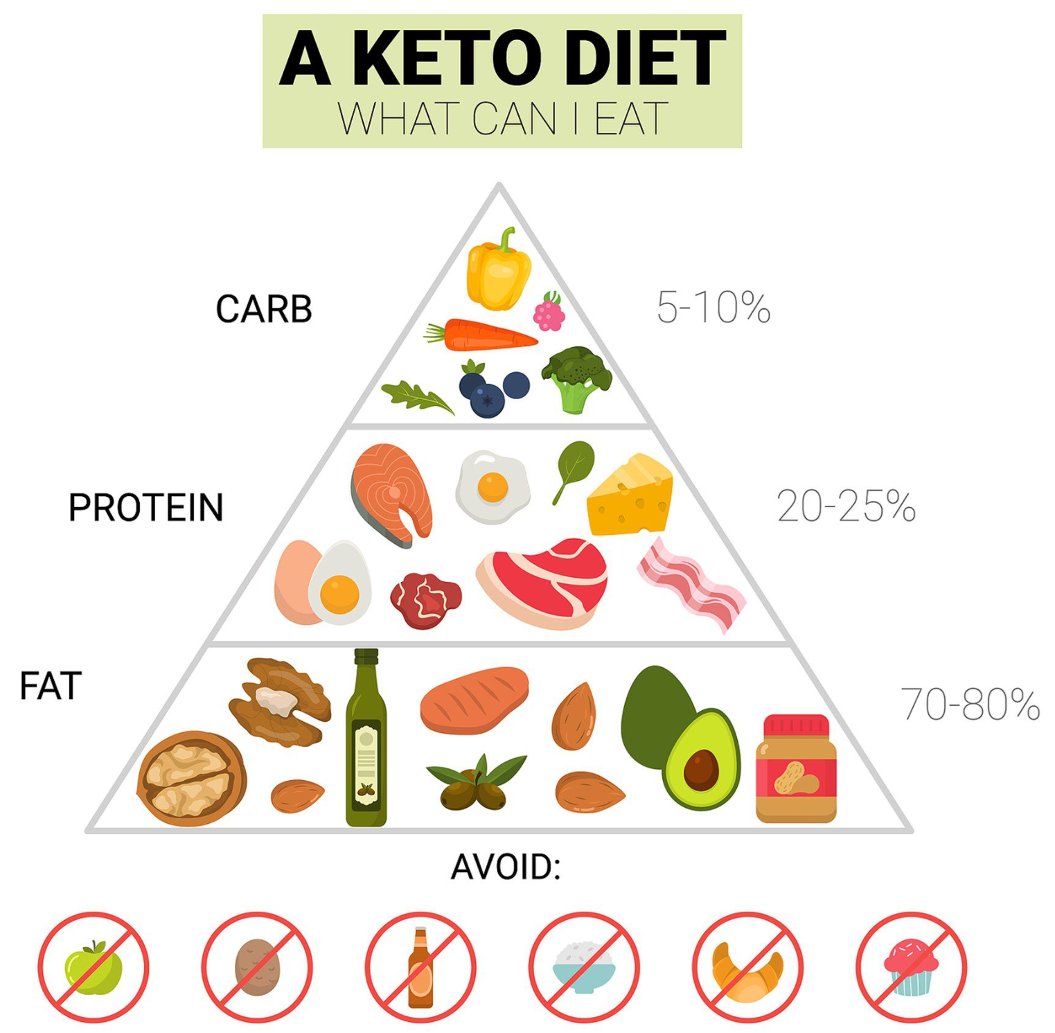
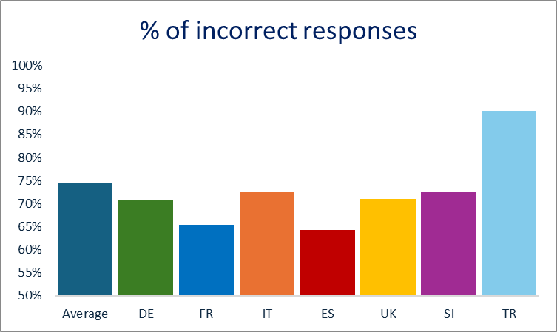
Confusion about carbs
“Carbohydrates cause weight gain.” (False)
Males are 17% more likely to answer incorrectly
Image source: https://elitelv.com/what-is-keto/?__cf_chl_tk=W9HPpxyZqXAnwhVsOpde4OMSOQZaT1V.sLW9QVeyc68-1718614171-0.0.1.1-5951
Naude, Celeste E., et al. "Low‐carbohydrate versus balanced‐carbohydrate diets for reducing weight and cardiovascular risk." Cochrane Database of Systematic Reviews 1 (2022).
Yang, Qing, et al. "The effects of low-fat, high-carbohydrate diets vs. low-carbohydrate, high-fat diets on weight, blood pressure, serum liquids and blood glucose: a systematic review and meta-analysis." European journal of clinical nutrition 76.1 (2022): 16-27.
Notes:
Another popular myth is that carbs cause weight gain, with almost 75% of people believing this, and males more likely to do so. One manifestion of this belief is the keto diet, which advises restricting carb intake to 5-10%, and increasing fat intake to 70-80%, which is very much against national dietary guidelines. However, there is no consistent evidence to support the myth that carbs themselves cause weight gain. 2022 review of the research found no difference in weight loss when people who were overweight and obese ate either low‐carbohydrate or balanced‐carbohydrate weight‐reducing diets. Another 2022 systematic review looked at the effectiveness of a low-fat, high-carbohydrate diet as compared to a low-carbohydrate, high-fat diet (like the keto diet) on weight loss and cardiovascular risk factors. The study authors concluded that both diets effectively helped control weight and reduced cardiovascular risk factors. At EUFIC, we are currently writing an article about the relationship between carbs and weight in order to address this the carb/weight gain myth.
#6 top nutrition myth.

Slide 23
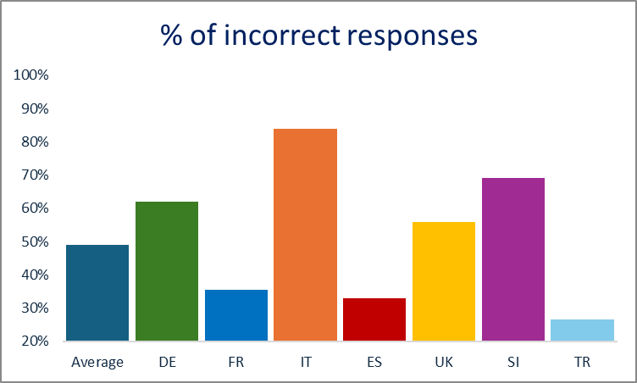
Confusion about dairy
“It's recommended to eat 2-3 portions of dairy per day.” (True)
Those with less education 27% more likely to answer incorrectly
46.3% don’t think that “Dairy products contain more saturated fats (also known as fatty acids) than vegetable oils.” (True)
45.9% think that “Skimmed milk contains fewer minerals than full fat milk” (False). More likely to be incorrectly answered by young adults by 0.5% per year decrease in age, by males by 22%, and by those with less education by 15%.
All countries had dietary guidelines recommending this.
Shen et al., (2022)
Notes:
Another myth for which there is huge country variation is that 49% of people don’t realise that it’s recommended to eat 2-3 portions of dairy per day, and those with less education are 27% more likely to get this wrong. Now all the countries in this study here make this dairy recommendation, so the country differences are not due to major differences in the recommendation itself, although there is some variation in the wording of the recommendation that may influence how easy it is to understand it. The fact that only about half of consumers know about this dairy recommendation is a particular problem because insufficient calcium intake can result in osteoporosis, which puts people at risk of persistent fragility fractures, and in Europe, fragility fractures are the fourth leading cause of chronic diseases, behind coronary heart disease, dementia and lung cancer. Not only are such fractures painful, but they often lead to serious psychological disorders such as depression, anxiety and fear, and they can cause huge economic pressure to society.
There were also other misconceptions about dairy, with 46.3% not realising that dairy products contain more saturated fats than vegetable oils, and 45.9% thinking erroneously that skimmed has less minerals than full fat milk.

Slide 24
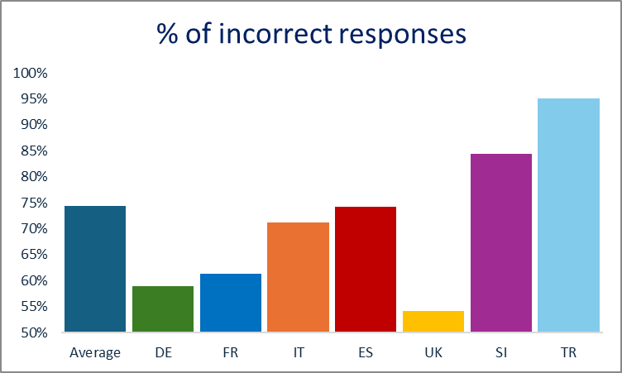
Confusion about fresh vs. lightly processed produce
“Fresh produce (e.g. fruit, vegetables, and meat) is healthier than frozen.” (False)
National dietary guidelines:
FR: It is recommended to increase fruit and vegetables consumption...All forms of fruit and vegetables are taken into account: fresh, frozen or canned [also fish].
IT: Consume more portions of fresh vegetables and fruit daily
UK: [Fruits & vegetables]: Choose from fresh, frozen, tinned, dried or juiced.
SI: Choose locally grown and fresh vegetables and fruits.
Younger adults more likely to think this by 12% more per year reduction in age
Males 38% more likely to think this
Those with more education 22% more likely to think this
Food-Based Dietary Guidelines recommendations for fruit and vegetables | Knowledge for policy (europa.eu)
Notes:
On a different topic, 74% of respondents think that fresh produce is healthier than frozen, although they are both nutritionally similar. This myth was subject to a lot of country variation. This variation might be related to the fact that some national dietary guidelines on this issue differ in a manner consistent with cultural differences in people’s beliefs. For example, people were less likely to think that fresh is nutritionally superior to frozen in FR and the UK, and these countries also explicitly mention frozen produce as being included in their fruit and vegetable recommendations. On the other hand, those in Italy and Slovenia were relatively more likely to think that fresh is best, and their national dietary guidelines also advise to consume vegetables and fruits that are fresh. One might think that because fresh produce is not nutritionally worse than frozen, it’s not necessarily a problem for people to hold this belief. But frozen produce does have other benefits over fresh that makes it easier for people to consume more fruits such and vegetables, such as being cheaper, saving people time, and helping them to reduce food waste. So it may be that communicating to people about the nutritional value of frozen produce may help them to more easily meet recommended consumption levels.

Slide 25


Slide 26
Target goals of the project
Early Warning and Emerging Risk Prediction Systems to identify and monitor existing and emerging food safety risks (ERI) in the food chain.​
Targeted and non-targeted detection methods for existing and emerging hazards.
Holistic risk assessment methods and tools to support regulation in a changing global environment.
Improved data and knowledge sharing infrastructures by developing an Integrated European Data and Knowledge Exchange Infrastructure that will be able to power an ecosystem of decision support systems.

Slide 27
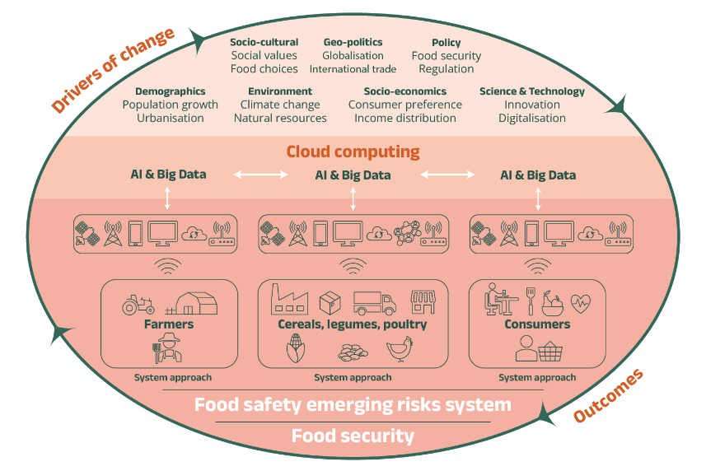
1) Utilize a systems approach
The point is to take into account the entire food production environment.
How? By combining Big Data and Artificial Intelligence techniques to support the delivery of early warning and risk prediction systems.

Slide 28

2) Produce a holistic risk assessment method
Holistic risk assessment methods embed food safety risk in a comprehensive cost-benefit analysis of the food system.
How ? By weighing up the positive and negative health, environmental, and economic dimensions.

Slide 29
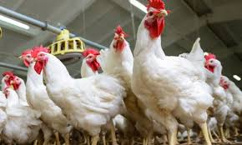
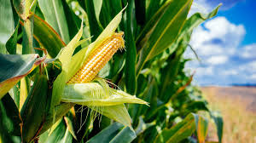
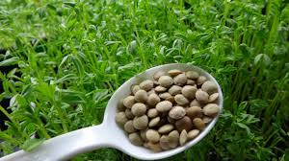
3) Study three supply chains
3 supply chains studied separately, in detail, for emerging and re-emerging risks : poultry, maize, and lentils
Why ? It will enable researchers to generate adaptive models that will be applied to the entire food system.
Notes:
→ Poultry and maize: selected in relation to the One Health principle and for their importance throughout Europe.
→ Lentils : selected as a small food crop for which an increase is expected due to its use as alternative to meat proteins.

Slide 30
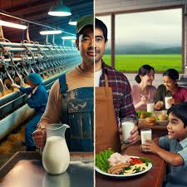
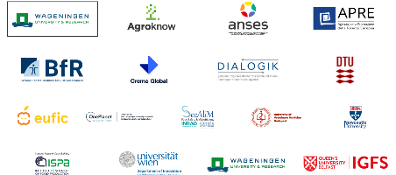
4) Integrate consumer and user requirements
We consider consumer preferences and user requirements at every stage of the project
How ? Using Living Labs and a multi-actor engagement approach to involve all stakeholders (e.g., authorities, food producers, and citizens).

Slide 31
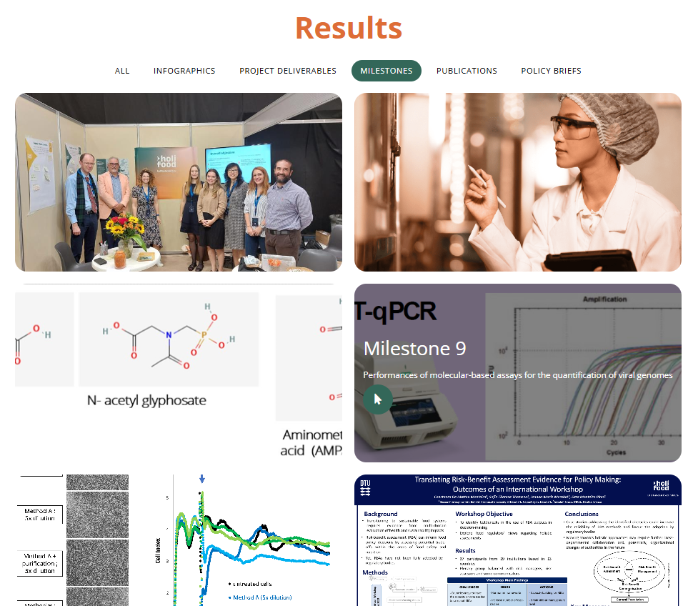
Project’s milestones and expected results
Please consult the milestones : https://holifoodproject.eu/results/
Please reach out to get involved ! https://holifoodproject.eu/stakeholder-participation-page/

Slide 32
Thank you!

