Slide 1

Anthony Warner
The Angry Chef, chef and writer
‘Why we fall for nutritional fake news ‘
@One_Angry_chef
#EUFIC2017

Slide 2
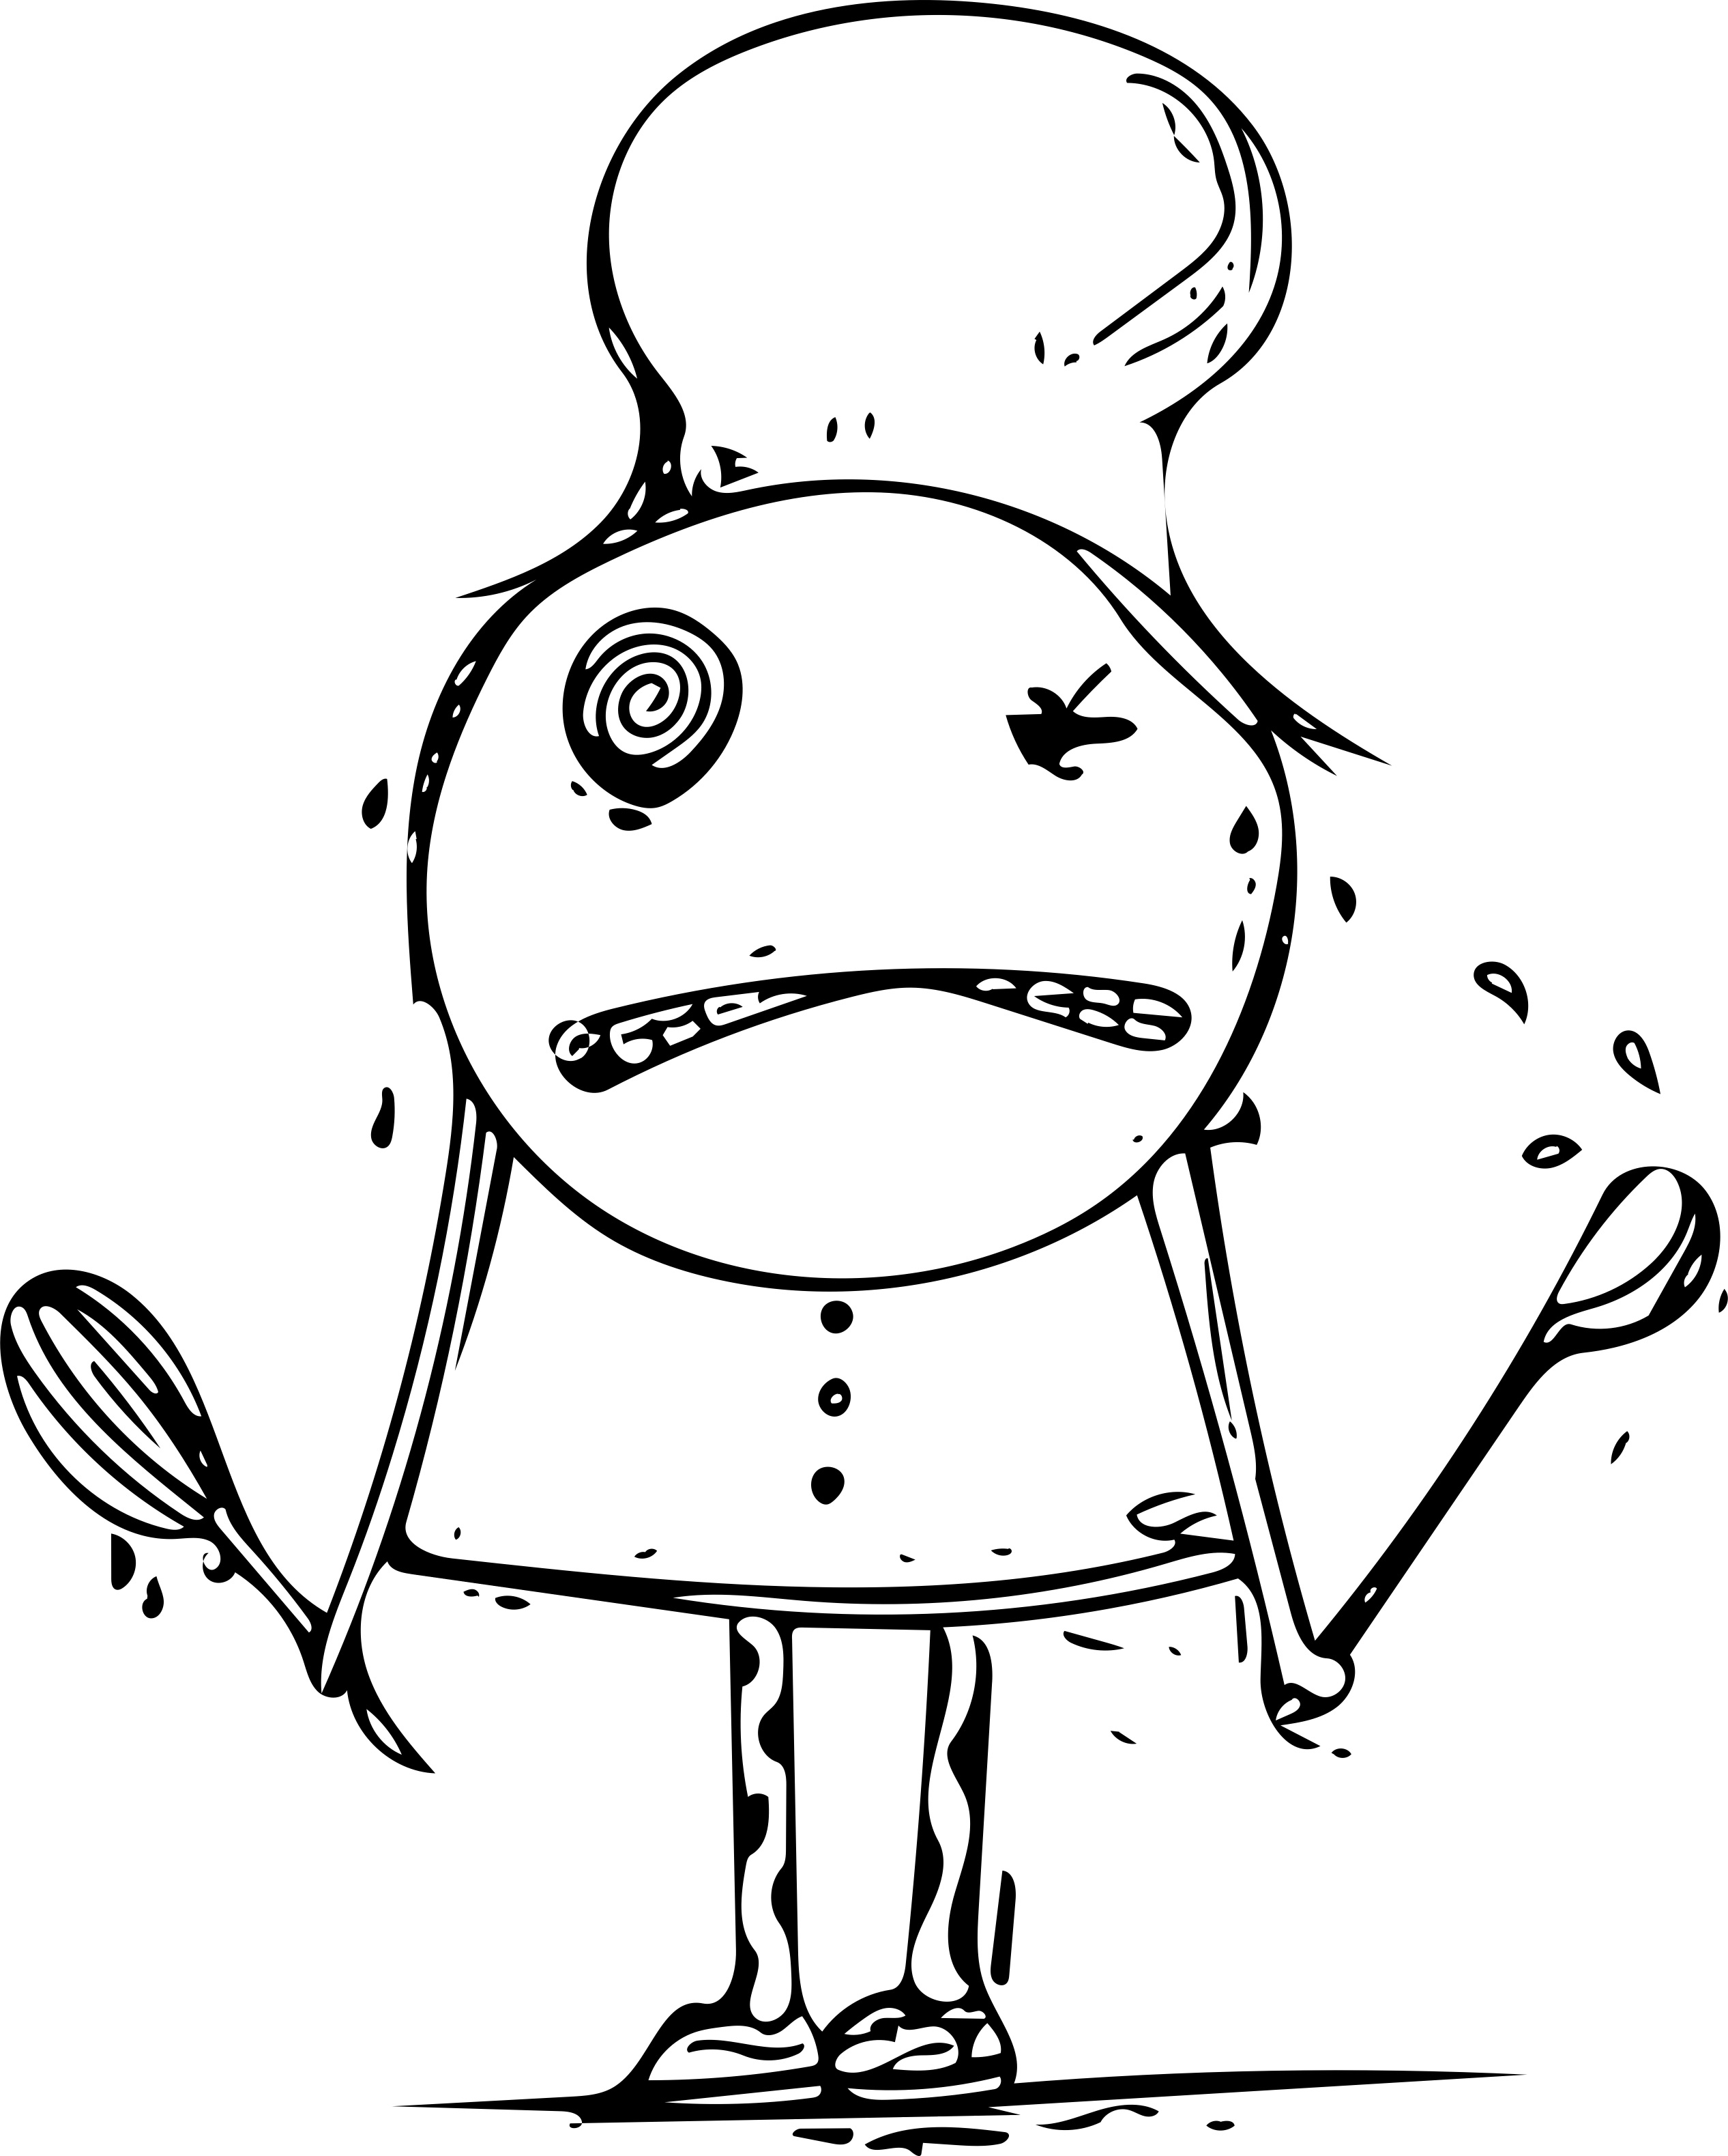
Why do we fall for nutritional fake news?
The Angry Chef

Slide 3
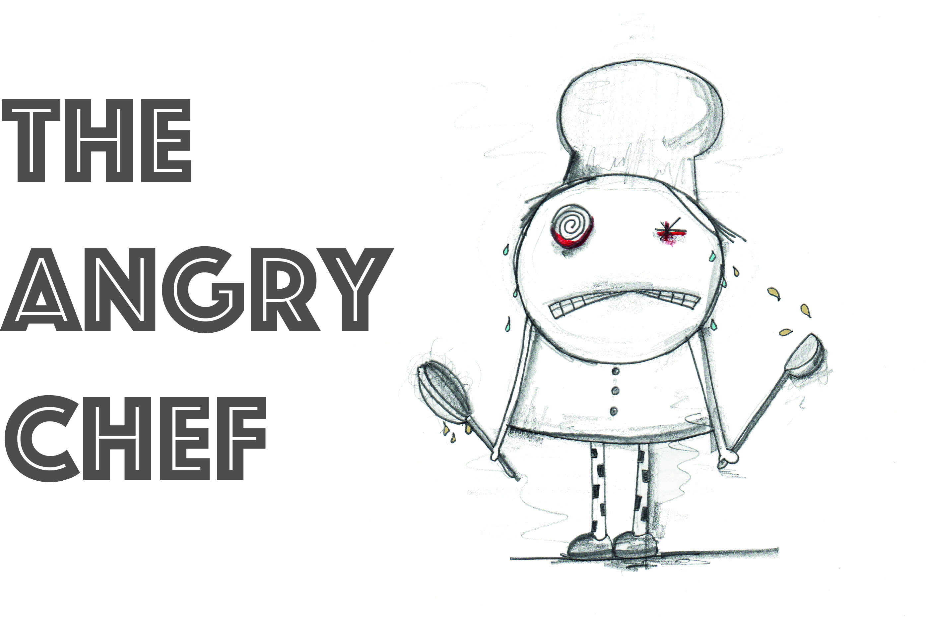

Slide 4
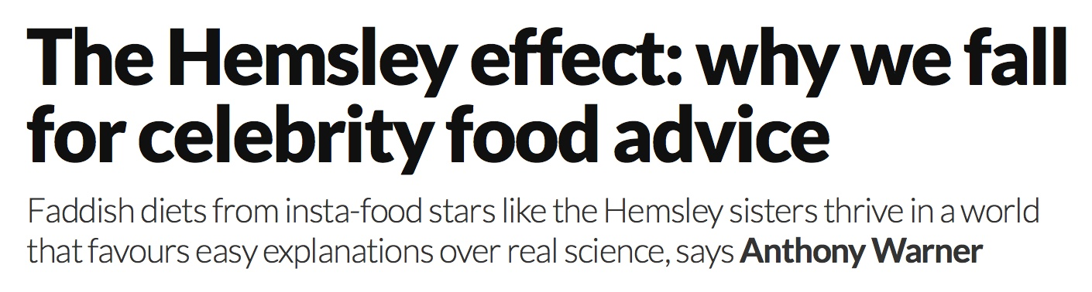


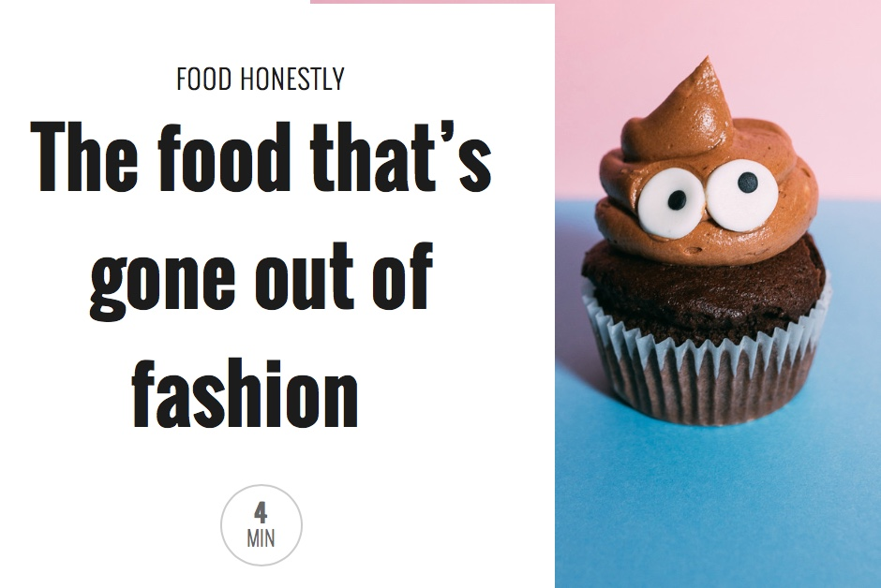
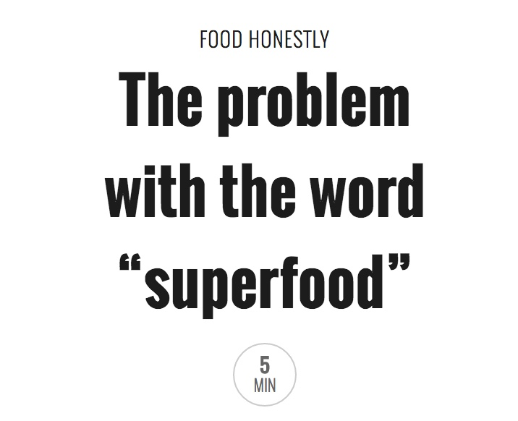
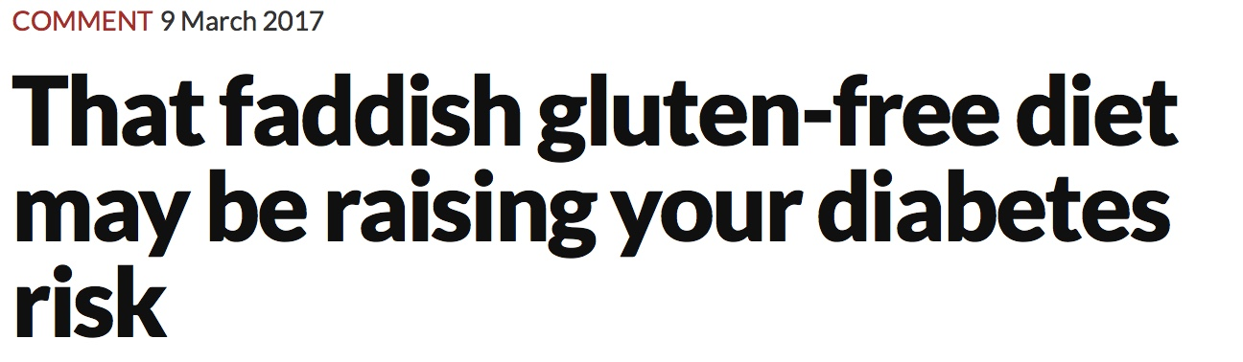
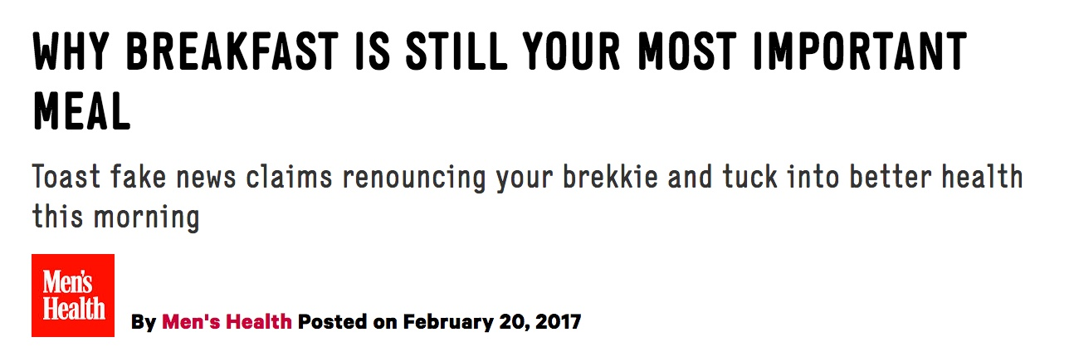
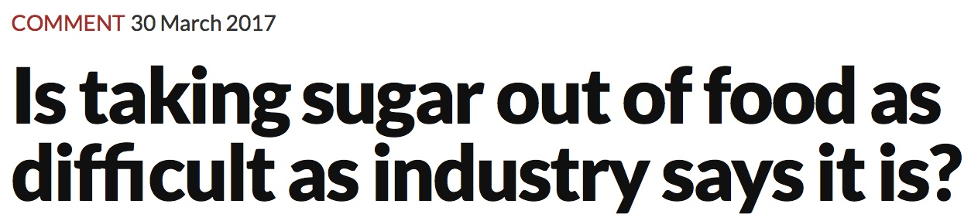
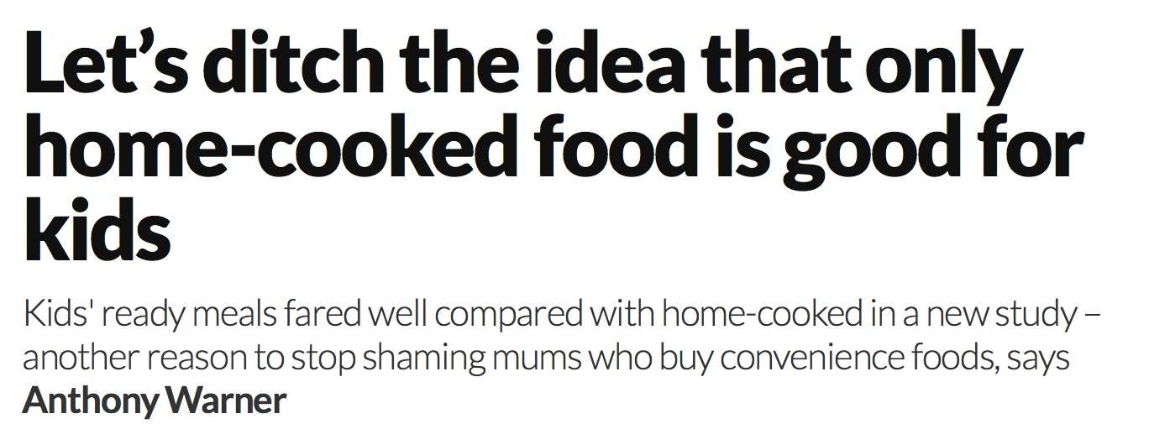

Slide 5
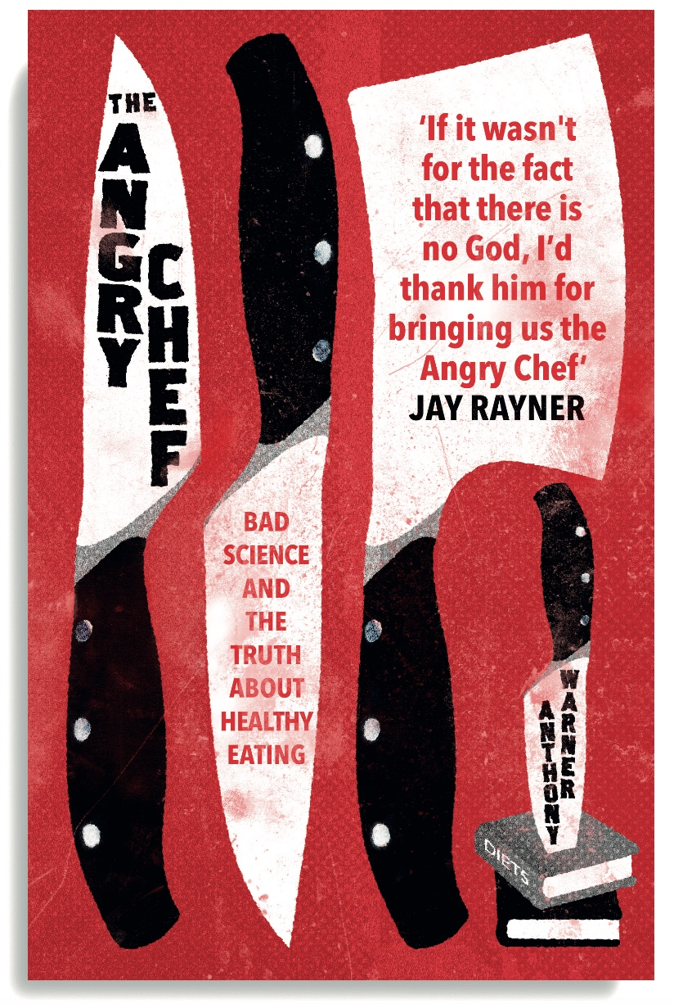
‘The popular understanding of nutrition is clouded by superstitions, primitive intuitions, conspiracy theories, and old spouses’ tales. This irreverent and intelligent exposé brings sanity and good sense to one of life’s great pleasures.’
Steven Pinker, Johnstone Professor of Psychology, Harvard University
‘The Angry Chef provides a refreshing insight into the importance of academic and scientific rigour in the interpretation and communication of nutrition.
Kevin Whelan, professor of dietetics, King’s College London
‘Thank God for the outspoken, intelligent, well-informed Anthony Warner. Someone had to say it (the Clean Gut cult is tosh) and he does – forcefully, amusingly and, convincingly.
Prue Leith

Slide 6
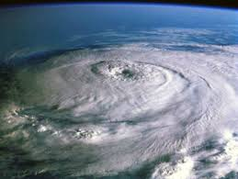

The Storm of Information

Slide 7



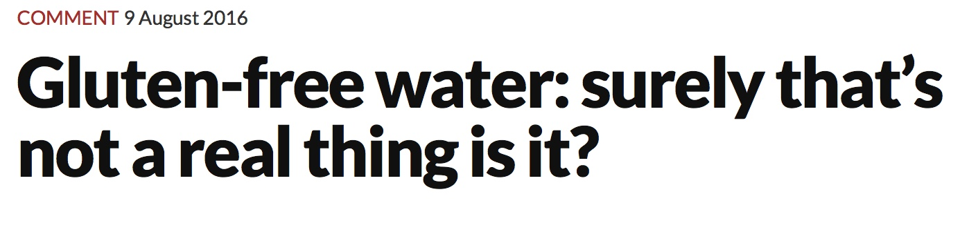

Slide 8

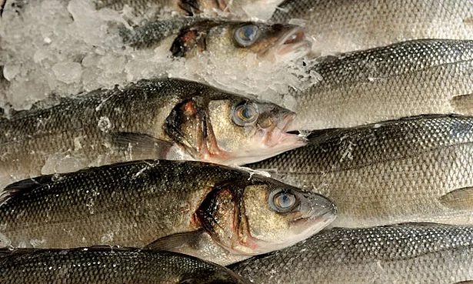
Time to think…

Slide 9
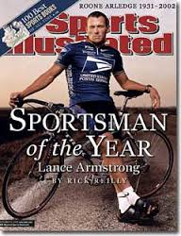
The Sports Illustrated Curse

Slide 10
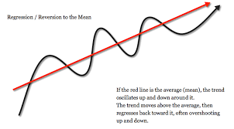
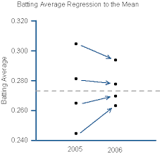
Regression to the Mean

Slide 11

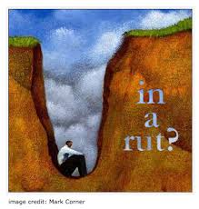
In a run of bad form?

Slide 12
The Angry Chef Health Blogger Template
‘I was living an impossibly glamorous lives as a model/PR/marketer at 100 miles an hour, eating all sort of junk and not caring what I put in my body. My health was really suffering. When I started my insert name of made up diet plan here it revolutionised my life and my friends just begged us to share my recipes with them’

Slide 13
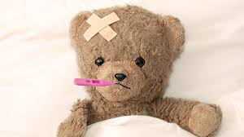
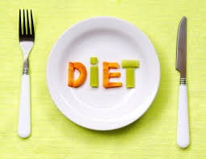



Slide 14

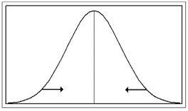

Slide 15
Prospect Theory – Decision Making Under Risk (1979)

Slide 16
Risky Games Part 1
Which Game do you want to play?
Game 1 – You give me £500. That’s it.
Game 2– Throw a dice. If you throw a six you don’t give me anything. If you throw anything else, you give me £600

Slide 17
Risky Games Part 2
Which Game do you want to play?
Game 1 – I give you £500. That’s it.
Game 2– Throw a dice. If you throw a six you get nothing. If you throw anything else, I give you £600.

Slide 18

But isn’t it all harmless?

Slide 19

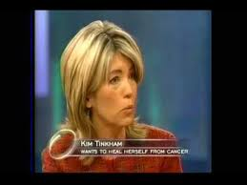

Is it harmless?

Slide 20
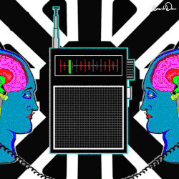
The Curse of Knowledge
1990 – Elizabeth Newton
120 Songs
Predicted success – 50%
Actual Success – 2.5%

Slide 21
Thank you for listening – Sorry for not being very Angry…

