Slide 1
Bart Penders
Associate Professor of Collaboration, Credibility and Integrity in Science, Maastricht University
‘Why dismissing nutrition science is perfectly rational’
@b_penders
#EUFIC2017

Slide 2
Why dismissing nutrition science is perfectly rational
Bart Penders
<B.Penders@MaastrichtUniversity.nl> | 2017

Slide 5
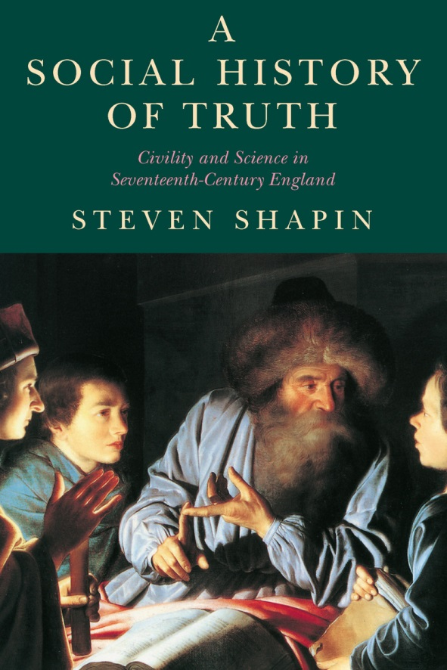
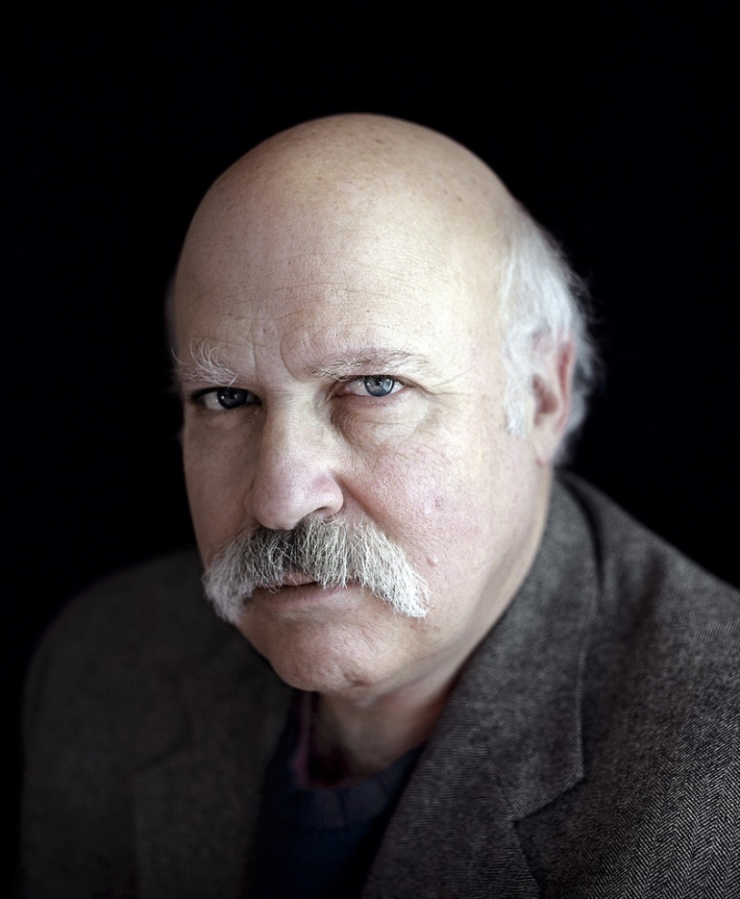

Slide 6
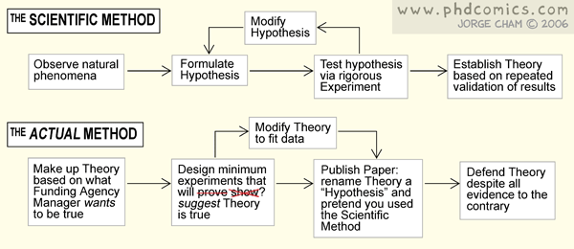
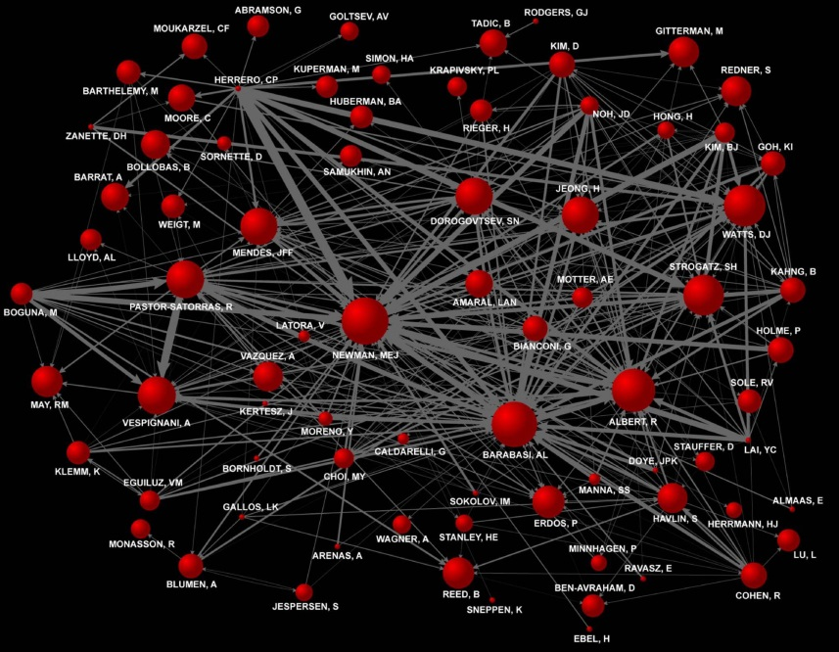

Slide 7
7/10

Slide 8
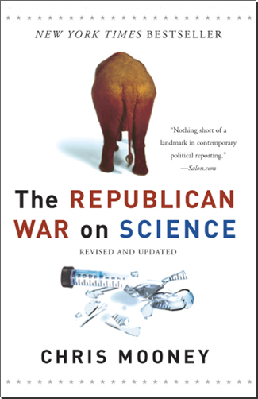
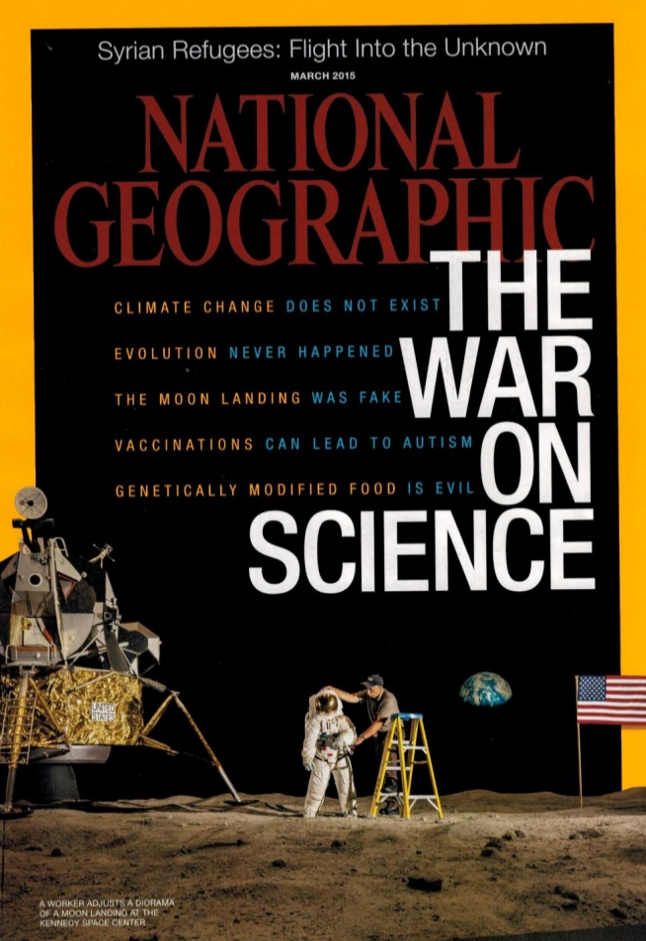
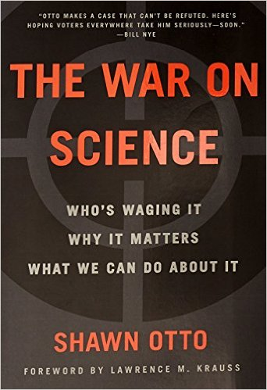
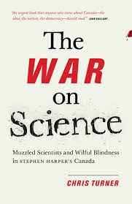
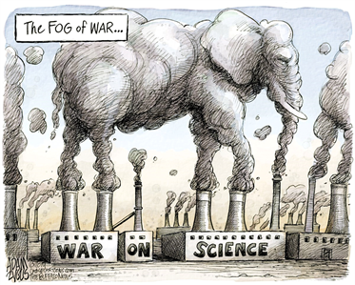

Slide 9
“They [republican politicians, BP] attack science's forms of truth‐making, its databases, and its budgets not out of a rejection of either science or truth, but as part of a coherent strategy to weaken the power of the federal agencies that rely on them”.
Clark Miller

Slide 11
“to protect the rights of scientists to pursue and communicate their inquiries unimpeded, expand the placement of scientists throughout the government, build public policies upon scientific evidence, and support broad educational efforts to expand public understanding of the scientific process.”
AAAS

Slide 12
The beautiful lie
“Scientific progress on a broad front results from the free play of free intellects, working on subjects of their own choice, in the manner dictated by their curiosity for exploration of the unknown.”
Daniel Sarewitz

Slide 13
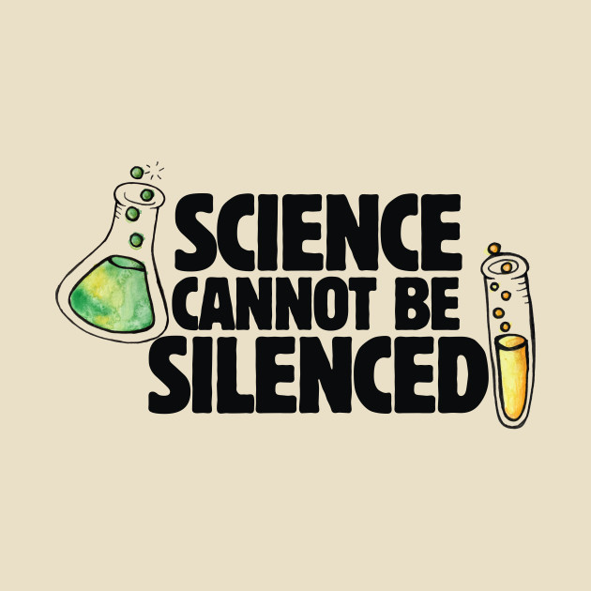

Slide 14
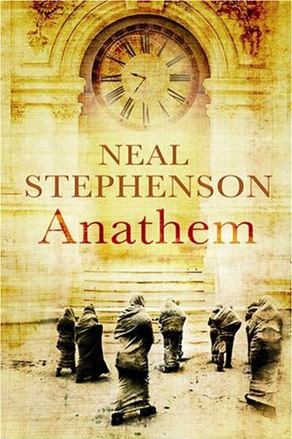

Slide 15
“Institutional corruption is manifest when there is a systemic and strategic influence which is legal, or even currently ethical, that undermines the institution’s effectiveness by diverting it from its purpose or weakening its ability to achieve its purpose, including, to the extent relevant to its purpose, weakening either the public’s trust in that institution or the institution’s inherent trustworthiness.”
Larry Lessig

Slide 16
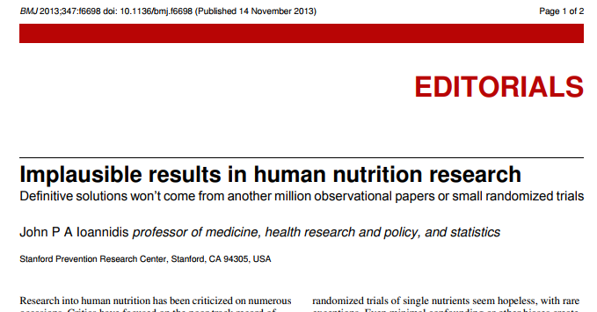

Slide 17
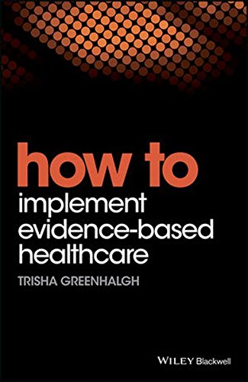

Slide 18
