Slide 1
Sourcing practices of health-related news
Bulent Capli, Bilkent University
Şerife Ozturk, Ankara University
Sule Karatas, Hacettepe University

Slide 2
Importance of Sourcing
Adds credibility and reliability to the news
Helps news consumers

Slide 3
How is sourcing presented?
Context and detail
The number
Transparency
Credibility
Variety

Slide 4
Sourcing of health-related news
The role of media

Slide 5
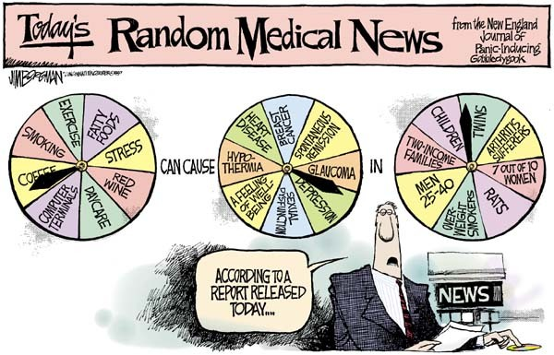

Slide 6
The Study
Three most popular internet news websites
Ten days in August 2017
285 health-related news
The number, variety and transparency
Different angles and perspectives

Slide 8
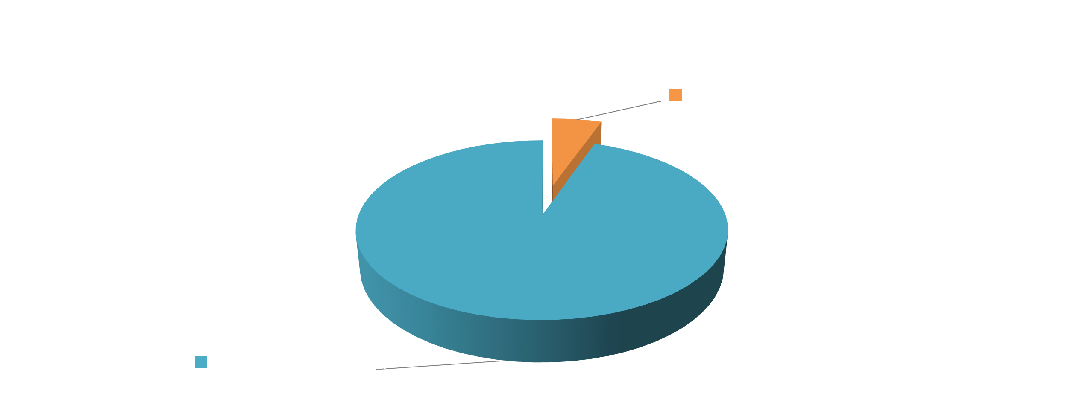

Slide 13
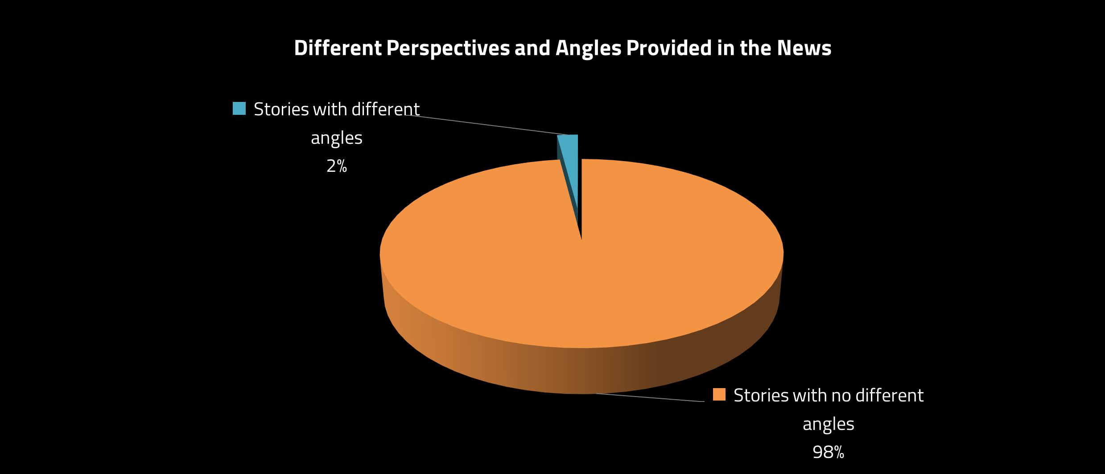

Slide 14
Conclusions
As the media is the consumers’ main source of health information,
News people should give as much context and detail as possible about sources and pay more attention to sourcing
Scientists and institutions need to translate science into meaningful messages

